Slide 1
ZERO-TRUST SECURITY
Presentation by Srimoyee Dutta
Third Year Computer Engineering
Notes:
Hello Sir good Afternoon, I will be presenting what I have learned so far about Zero trust Security and its Architecture.

Slide 2
Today's Presentation
DISCUSSION POINTS
Traditional Security and its drawbacks
Zero trust architecture
Why Zero trust is necessary
Benefits of Zero trust
Disadvantages of Zero trust
Implementing Zero trust model
Notes:
So I will Talk about the traditional security system, need for Zero trust Architecture, and the benefits and disadvantages and implementing of Zero trust Security and its principles.

Slide 3
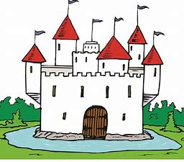
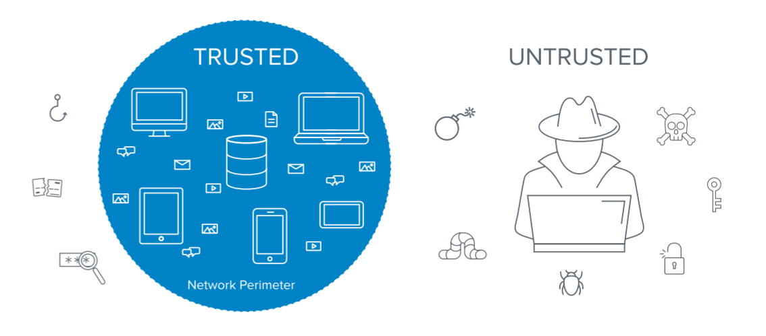
Traditional (Castle-Moat) Security
Perimeter based Networks
Assumes all systems and users inside the perimeter can be trusted
Attacker can compromise single endpoint within trusted boundary and quickly expand their foothold through the entire network
Not able to accommodate modern work styles (such as BYOD, work-from-home, etc.)
Notes:
So Previously, we had the castle-moat type of security, which was perimeter based, centralized security system. Anything that was within The defined network perimeter, was trusted and devices/users outside the perimeter were untrusted. This gave the insiders the freedom of lateral movement, and they had free access within the perimeter. This proved to be a major setback, as if a malicious attacker compromised a single device within the perimeter, he could gain all the information he wanted through lateral movement, and this breach could take days to detect, since the activity within the perimeter was not monitored.

Slide 4
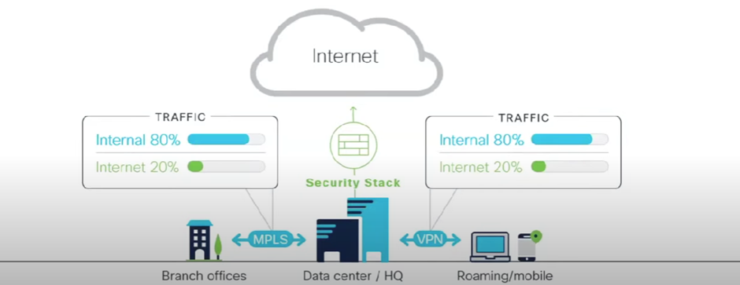
Centralized Security
Most traffic was internal
Internet was used for browsing/light traffic
Most of the work was done at office, inside the defined trusted network perimeter.
Notes:
We also had a centralized security system previously, as most of the traffic was internal. The vast majority of data and applications was at the data centre or the HQ and that was where the traffic went to and fro most often. So the networking and security infrastructure revolved around the data centre or HQ. the traffic through internet where most of the malicious users are/ attacks happen was very less. Internet was previously used just for browsing, or very light traffic, and could be easily controlled through a security stack and anyone wanting to access the internet could go through the security at the central data centre and HQ.

Slide 5
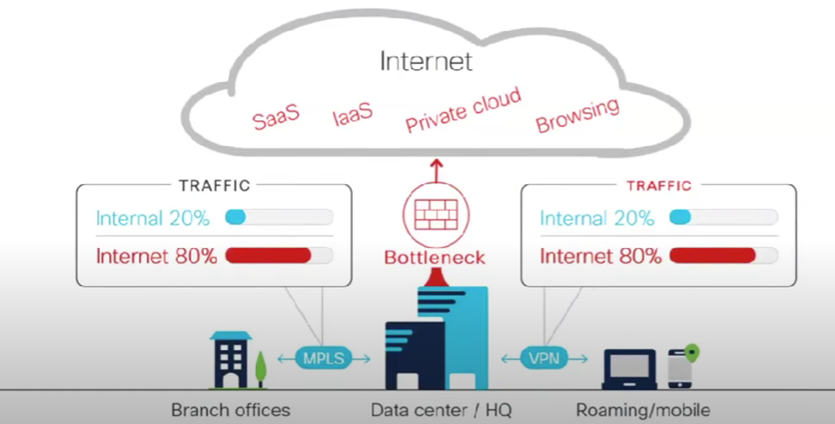
Drawbacks of Centralized System
Costly
Low Performance
More No. of tools needed
More Integrations
High Maintenance
Notes:
But now, with the changing workplace environment, and digitalization, and everything being remote, things have changed. The type of traffic across a network has changed. Many organizations are hosting more and more of their applications on cloud, and with Saas applications, Infrastructure as a Service, private clouds, increased amount of browsing, leading to an increased volume of internet traffic. Now with a complete inversion in the type of traffic, it changes the dynamic of setting up the network and security system. It causes a lot of problems as well, like the cost and maintenance, the no. of tools required and integrations that are needed for it, and it affects the performance of the network as well. The vpn and mpls communication setup is also expensive. So this is indirect traffic, where all of it is going through a data centre, and then out to the internet through a single checkpoint and security appliances/devices. so it kind of creates a bottleneck when such huge amount of traffic is being centrally directed.

Slide 6
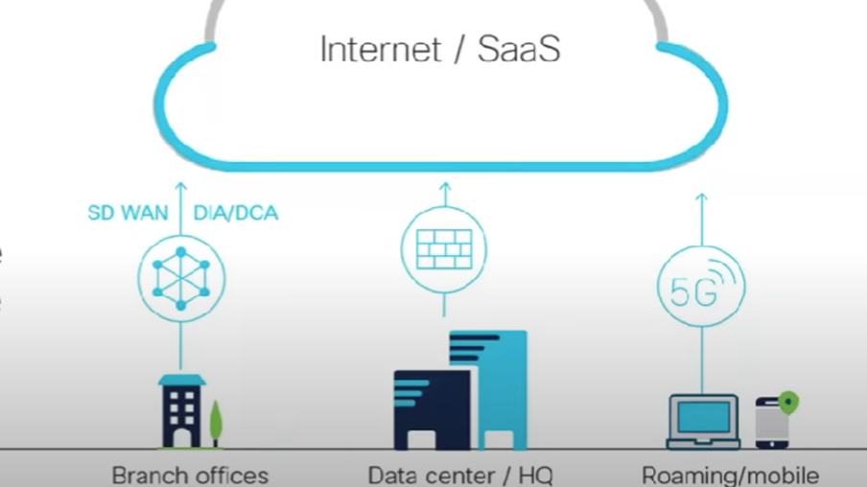
Decentralized System
Direct Internet Access
Better Performance
Not much Maintenance
Less expensive compared to Centralized Security System
Notes:
SO instead of the indirect centralized way, people shifted to a decentralized system of security. In this modern approach, we allow direct internet access, whether its applications that are in infrastructure as a service, or Saas apps, or cloud storage. so that is where Lot of performance sensitive traffic is going, so we allow direct internet access. So we run a security check at the edge of the cloud and then direct the traffic to its destination. So this decentralised system, no has a better performance, as the delay from the bottleneck in the previous centralized system has been eliminated. It does not need much maintenance and is less expensive compared to the Centralized Security System. But when we make the switch from the old model to this new one, there could be gaps in security. We are now no longer going through the centralized security stack, and there could be differences with regard to roaming users and branches about how to securely connect and maintain a secure network. And now, with Direct Internet Access, the perimeter that was previously defined is no longer effective, and the castle moat security system becomes very inefficient.

Slide 7
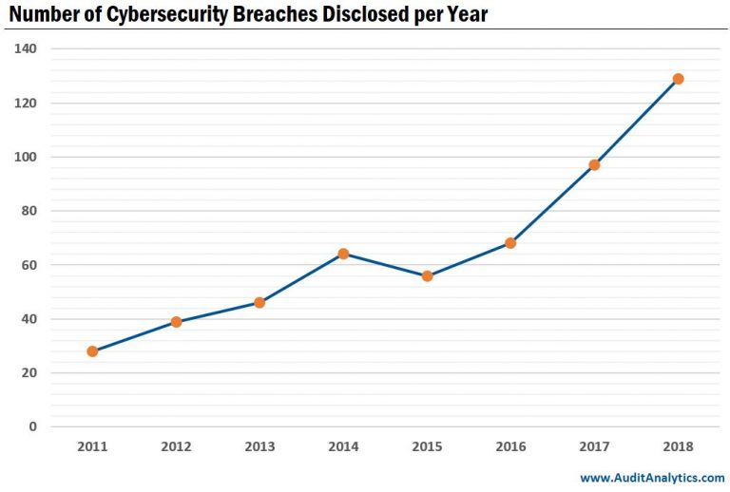
Notes:
And like we can see, the graph depicts the number of security breaches disclosed per year from 2011 to 2018. And the sharp ascending slope of the line graph tells us exactly how important it is to find a proper security solution that helps keep our data safe and it should not cause hinderance in work flow either. Now with so many changes in the past few years, digitalization and working remotely, the threat of data breach has increased immensely. So following the traditional approach of castle moat security does not help protect the data effectively.

Slide 8
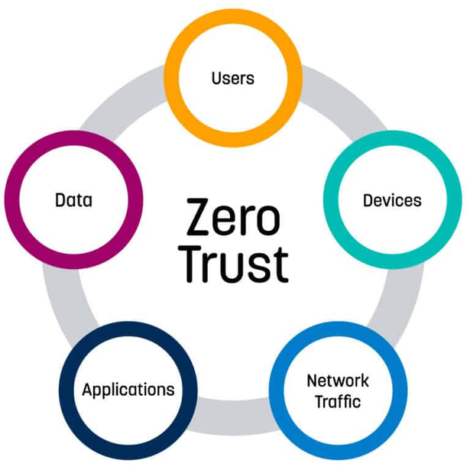
WHAT IS ZERO TRUST?
It means that we do not blindly trust any device/user, unless they have proven they are trustworthy. The zero trust security model ensures data and resources are inaccessible by default.
Zero Trust
Assumes hostile environment
Doesn't distinguish between internal and external
Prevents/Restricts Lateral Movement
Notes:
Coming to the term, "Zero trust" created by John Kindervag, it is quite self explanatory. It means, we do not trust anyone unless they have established the trust through authentication. Zero trust is all about removing trust from the network, and embracing default deny, and least privilege access principle.
A zero trust architecture uses zero trust principles to plan industrial and enterprise infrastructure and workflows.

Slide 9
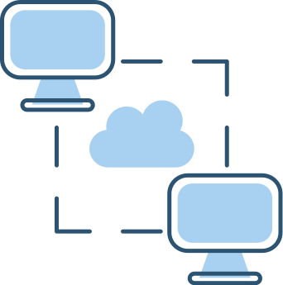
UNTRUSTED TRAFFIC
MICRO-SEGMENTATION
ASSESS TRUST DYNAMICALLY
IDENTITY BASED SEGMENTATION
LEAST PRIVILEGE ACCESS
ASSESS TRUST THE SAME WAY
Principles of Zero-Trust
Notes:
SO the first and foremost principle is all network traffic is untrusted, all of it should be inspected and
logged.
The next is micro-segmentation, All networks should be finely segmented and access control
policies should be enforced between segments. Without this very granular
segmentation, attackers who have acquired user credentials
or compromised a system can roam freely across the entire
infrastructure and so can malicious insiders. Hence through micro-segmentation, lateral movement can be restricted.
Another important principle is that trust should be assessed dynamically and in the same way. And to keep the security top priority, principle of least privilege access should be implemented.
All of these principles put together form a zero trust architecture, which provides visibility into network traffic and protection of cloud workloads, endpoints and applications.

Slide 10
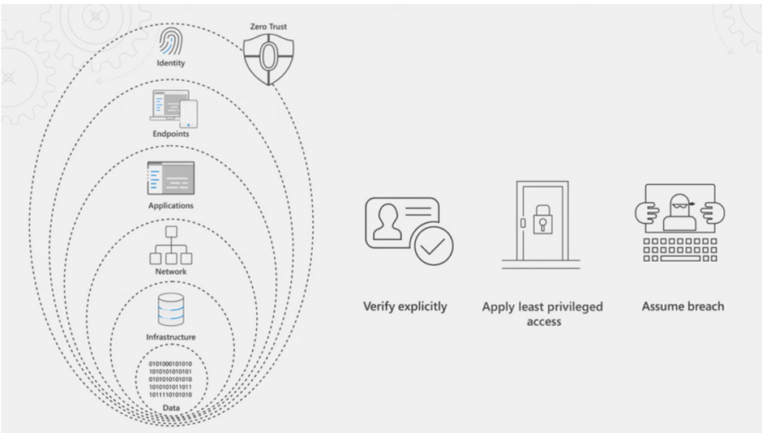
Notes:
working on the principles of verify explicitly, apply least privilege access and always assume breach, zero trust establishes a comprehensive control plan across multiple layers of defense.
Starting with identity, it ensures that only people, devices and processes tat have proper authority are granted access to resources. Even Endpoints including Iot Systems accessing your resources are assessed. This is also used in case of applications (whether cloud or local) as software level entry-point to our information/data. There are protections at the network layer for access to resources especially for the ones within the corporate perimeter. it is followed by infrastructure, hosting data both on premise, or on cloud, it could be physical or virtual, including underlying operating systems and firmware. And the last layer is the data itself across your files and content as well as structured and unstructured data wherever it resides. Each of these layers are important links in the chain of zero trust. Each link could be exploited by malicious users to leak sensitive information. The aim of zero trust is not to disrupt end users, but to work in the background to keep the users secure and in their flow as they work. The key here is end to end visibility and it brings all of this together with threat intelligence, risk detection, and conditional access policies to reason over access requests and eventually automate the response. But why is it necessary to implement Zero trust Architecture?

Slide 11
Why Zero Trust?
Perimeter-Based Security is Ineffective in the Evolving Enterprise
Cloud Data Centers Require Shared Security Responsibility
Third-Party SaaS and PaaS Applications Can’t Be Trusted Blindly
The Internet Network is an Unsecured Network
Everyone in the Expanding Workforce Shouldn’t Have All-Access
You Cannot Verify the Security Status of All WFH Environments
BYOD is Not as Secure as Work Devices
Cyberattacks Are Increasing
Advanced Persistent Threats (APTs) Are Becoming More Sophisticated
The Security Stakes Are Higher

Slide 12
1.GAIN GREATER VISIBILITY
Benefits
of
Zero Trust
2.PREVENTS DATA BREACHES
3.OPTIMIZING SECURITY STAFF
4.SECURE REMOTE WORKFORCE
Notes:
There are quite a few benefits of implementing Zero trust Security. It provides you with full visibility into precisely who (or what) accesses your network — so you know the time, location, and applications involved in every access request.
It prevents data breaches by micro-segmentation and isolating high value assets, so lateral movement is restricted, and data can be safe to some extent. Furthermore, limiting what a user can access and how long they can access it goes a long way in reducing the impact of a breach. If access is restricted to only a limited dataset — and is time-bound — attackers have a much lower chance of getting the data they’re looking for when they’re looking for it.
Next, Zero trust can help security staff to work smarter, as it utilizes centralized monitoring, and you can easily generate reliable data stored in a single location. So this facilitates robust analytics, and the team can gain insights they wouldn’t have been able to otherwise. So, now the security team can maintain a more secure environment with fewer staff.
Zero trust Security is also known as perimeterless security. Here identity is the perimeter. Firewalls are no longer sufficient now that users are spread across the world, and data is spread across the cloud. Identity is attached to the users, devices, and applications seeking access, so Zero Trust offers robust protection for workers and data in any location.

Slide 13
TAKES TIME AND EFFORT TO SET UP
1. DIFFERENT WAYS TO STORE AND ACCESS DATA
Drawbacks
of
Zero Trust
2.MORE DEVICES TO MANAGE
3.INCREASED MANAGEMENT OF VARIED USERS
4.MORE COMPLICATED APPLICATION MANAGEMENT
Notes:
Though the idea of Zero trust security, and implementing the architecture is beneficial, we also need to put on a black hat, and think of a few drawbacks before we jump into it.
The first and most obvious thing to think about is the time and efforts such an architecture like this would require to set up. This is probably the only major set back and the other drawbacks revolve around this one. So Reorganizing policies within an existing network can be difficult because it still needs to function during the transition. Often it’s actually easier to build a new network from scratch and then switch over, but that would increase cost. Next Employee users need to be monitored more closely with access only granted as necessary. And users can go beyond employees. Customers, clients and third-party vendors may also use the company’s website or access data. This means there’s a wide variety of access points, and a Zero Trust framework requires specific policies for each type of group. This would mean more work to be taken into consideration and longer to set up. Today’s work environment includes not only different kinds of users, but several types of devices for each of them. Different devices may have their own properties and communication protocols which must be monitored and secured specific to their type. So that also needs to be adjusted while set up, and makes device management complicated. Likewise, applications are also varied. Apps are often cloud-based and are used across multiple platforms. They may be shared with third parties. In line with a Zero Trust mentality, app use should be planned, monitored and tailored specifically to user need. This could be time consuming and often complicated to implement. These days there’s more than one location where data is stored, which means there are more sites to protect. Data configuration needs to be done responsibly with the highest security standards. This also has to be frequently updated as the data locations change.

Slide 14
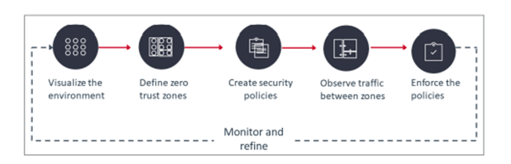
Ways to Implement Zero Trust
Visualize the environment
Define zero trust zones
Create policies
Observe traffic between zero trust zones
Enforce the security policies
Monitor and refine the zero trust zones and policies
Notes:
Visualizing the environment provides a lot of value right away.
Observing network traffic can reveal indicators of attacks. A
map of connected entities can be used forensically to trace
lateral movement by attackers.
zero trust zones could be
collections of information resources that should be segmented, monitored and protected as a unit, using one set of
access policies. We also need to Determine the areas which require the most amount of security to the least amount of security.
Outline the users who can access these areas and what security measures they will use to access them. These include Multi-factor Authentications. The next step after defining zero trust zones is to create security policies to control access between them. Direct enforcement of security policies could lead to one of them preventing a top executive from
performing an urgent task. To avoid hinderance in work flow we need observation period. you can observe production network traffic and generate alerts
based on your policies, but do not actually block any connection. You investigate the alerts to find out which are critical
and which are false positives. And the final step being implementing! When you enforce the security policies, you protect the zero trust zones from attackers moving laterally and from insiders trying to reach resources they are not authorized to use. We also need Continued Monitoring, Observation, Testing, and Evaluation. Organizations are constantly adding and changing applications, modifying their infrastructure, and giving users new roles. It is important to monitor those changes and continuously update zero trust zones with dynamic policies that
protect them.

Slide 15
THANK YOU
Notes:
So that was all That I had to present about Zero trust architecture and its benefits and disadvantages. Thank you so much for giving me this opportunity and listening patiently.

